Slide 1
Hardwired Control Unit

Slide 2
Hardwired Control Unit
A hardwired control is a method of generating control signals with the help of Finite State Machines (FSM).
It’s made in the form of a sequential logic circuit by physically connecting components such as flip-flops, gates, etc that result in the finished circuit. As a result, it’s known as a hardwired controller.

Slide 3
Hardwired Control Unit
The control signals that are necessary for instruction execution control in the Hardwired Control Unit are generated by specially built hardware logical circuits, and we can’t change the signal production mechanism without physically changing the circuit structure.

Slide 4
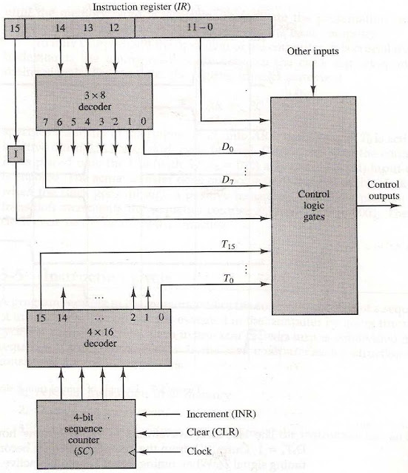

Slide 5
Hardwired Control Unit
It consists of two decoders, a sequence counter, and a number of control logic gates.
An instruction read from memory is placed in the instruction resister (IR) where it is decoded into three parts: I bit, operation code and bits 0 through 11.
The operation code bit is decoded with 3 x 8 decoder producing 8 outputs D0 through D7.

Slide 6
Hardwired Control Unit
Bit 15 of the instruction is transferred to a flip-flop I.
And operand bits are applied to control logic gates.
The 16 outputs of 4-bit sequence counter (SC) are decoded into 16 timing signals T0 through T15.

Slide 7
Designing of Hardwired Control Unit
The following are some of the ways for constructing hardwired control logic that have been proposed:
Sequence Counter Method − It is the most practical way to design a somewhat complex controller.
Delay Element Method – For creating the sequence of control signals, this method relies on the usage of timed delay elements.
State Table Method − The standard algorithmic approach to designing the Notes controller utilising the classical state table method is used in this method.

Slide 8
Working of a Hardwired Control Unit
The basic data for control signal creation is contained in the operation code of an instruction.
The operation code is decoded in the instruction decoder. The instruction decoder is a collection of decoders that decode various fields of the instruction opcode.

Slide 9
Timing Signals of hardwired control unit :
Generated by 4-bit sequence counter and 4x16 decoder.
The SC can be incremented or cleared.
Example: T0, T1, T2, T3, T4, T0, T1 . . .
Assume: At time T4, SC is cleared to 0 if decoder output D3 is active: D3T4: SC <¬ 0

Slide 10
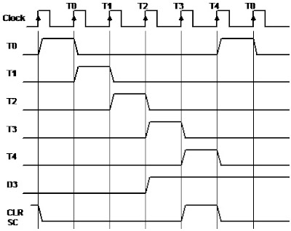

Slide 11
Advantages of Hardwired Control Unit :
Because of the use of combinational circuits to generate signals, Hardwired Control Unit is fast.
It depends on number of gates, how much delay can occur in generation of control signals.
It can be optimized to produce the fast mode of operation.
Faster than micro- programmed control unit.

Slide 12
Disadvantages of Hardwired Control Unit :
The complexity of the design increases as we require more control signals to be generated (need of more encoders & decoders)
Modifications in the control signals are very difficult because it requires rearranging of wires in the hardware circuit.
Adding a new feature is difficult & complex.
Difficult to test & correct mistakes in the original design.
It is Expensive.

Slide 13
Hardwired Control Unit | Microprogrammed Control Unit
Hardwired control unit generates the control signals needed for the processor using logic circuits | Micrprogrammed control unit generates the control signals with the help of micro instructions stored in control memory
Hardwired control unit is faster when compared to micro programmed control unit as the required control signals are generated with the help of hardware | This is slower than the other as micro instructions are used for generating signals here
Difficult to modify as the control signals that need to be generated are hard wired | Easy to modify as the modification need to be done only at the instruction level
More costlier as everything has to be realized in terms of logic gates | Less costlier than hardwired control as only micro instructions are used for generating control signals
It cannot handle complex instructions as the circuit design for it becomes complex | It can handle complex instructions
Only limited number of instructions are used due to the hardware implementation | Control signals for many instructions can be generated
Used in computer that makes use of Reduced Instruction Set Computers(RISC) | Used in computer that makes use of Complex Instruction Set Computers(CISC)

Slide 14
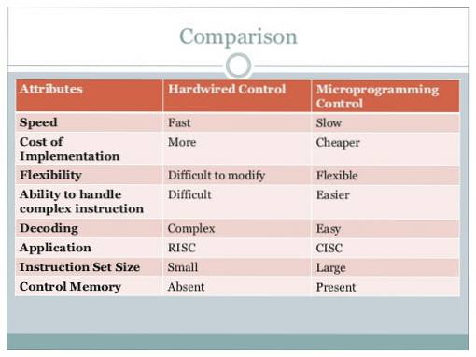

Slide 15


